Slide 2
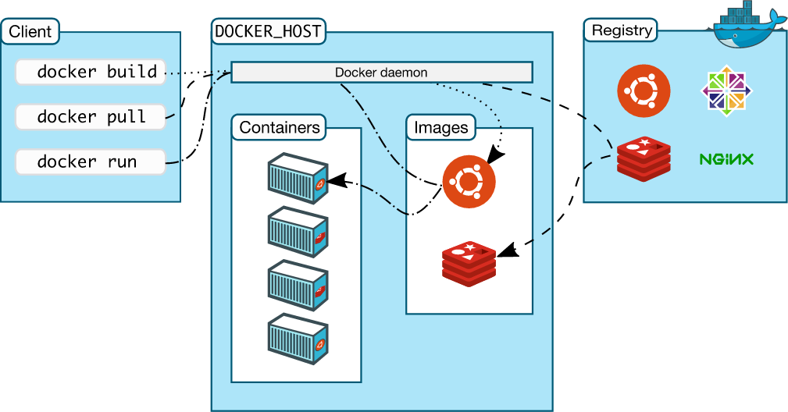
Architecture

Slide 3
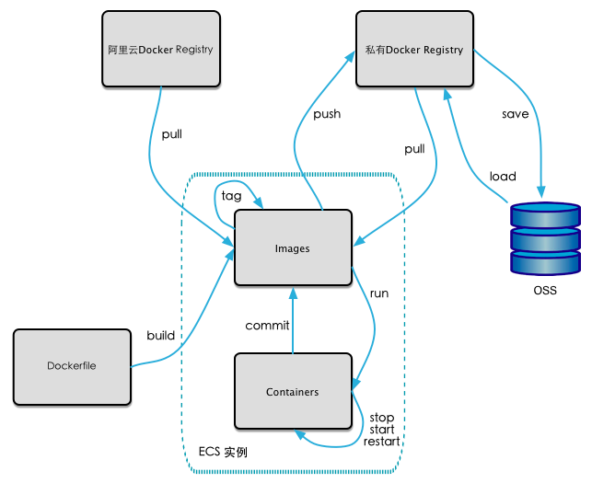
Docker

Slide 4
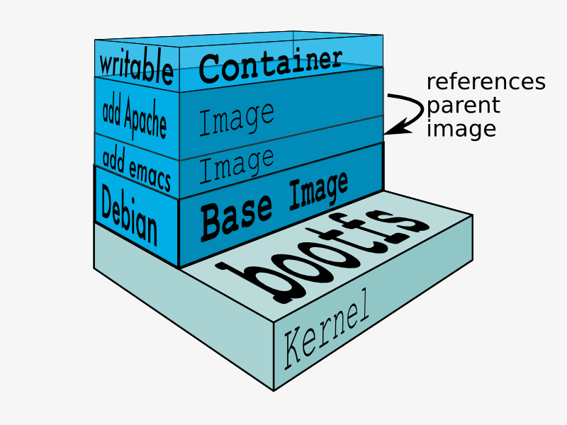
Image layer

Slide 5
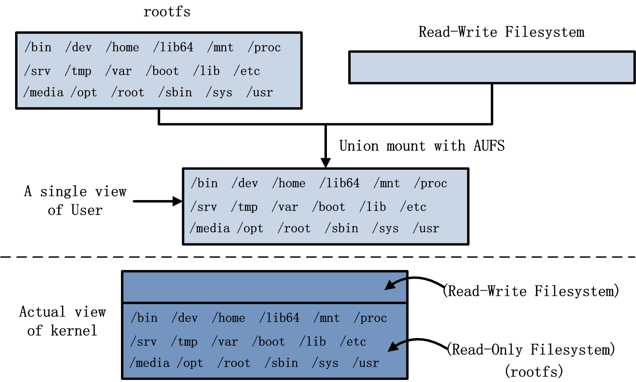
Image

Slide 6
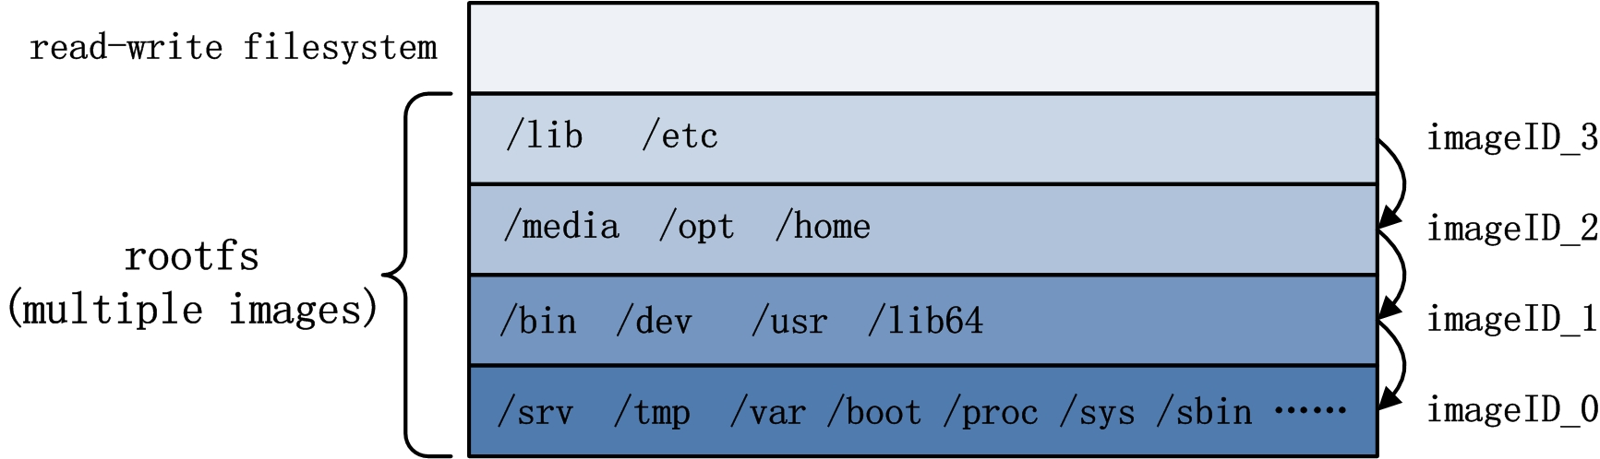
Image Layer

Slide 7
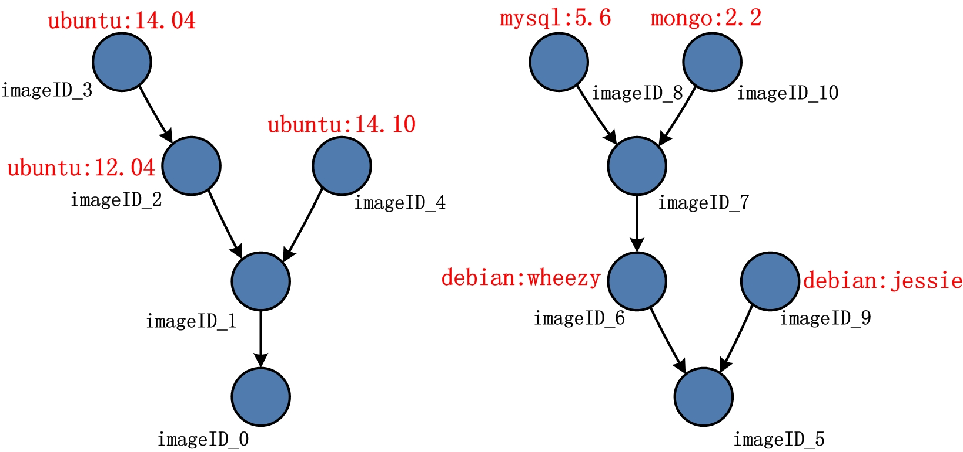
Image layer

Slide 8
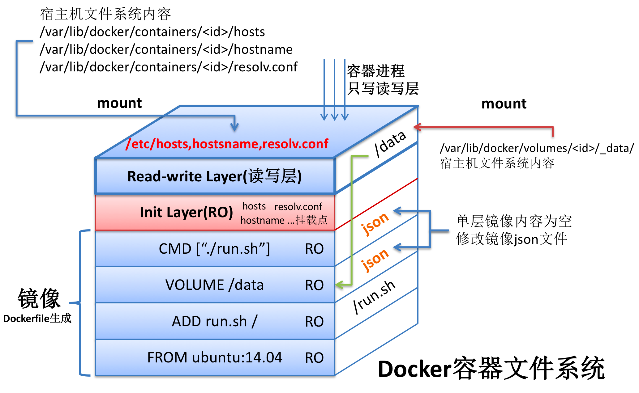
Container

Slide 9
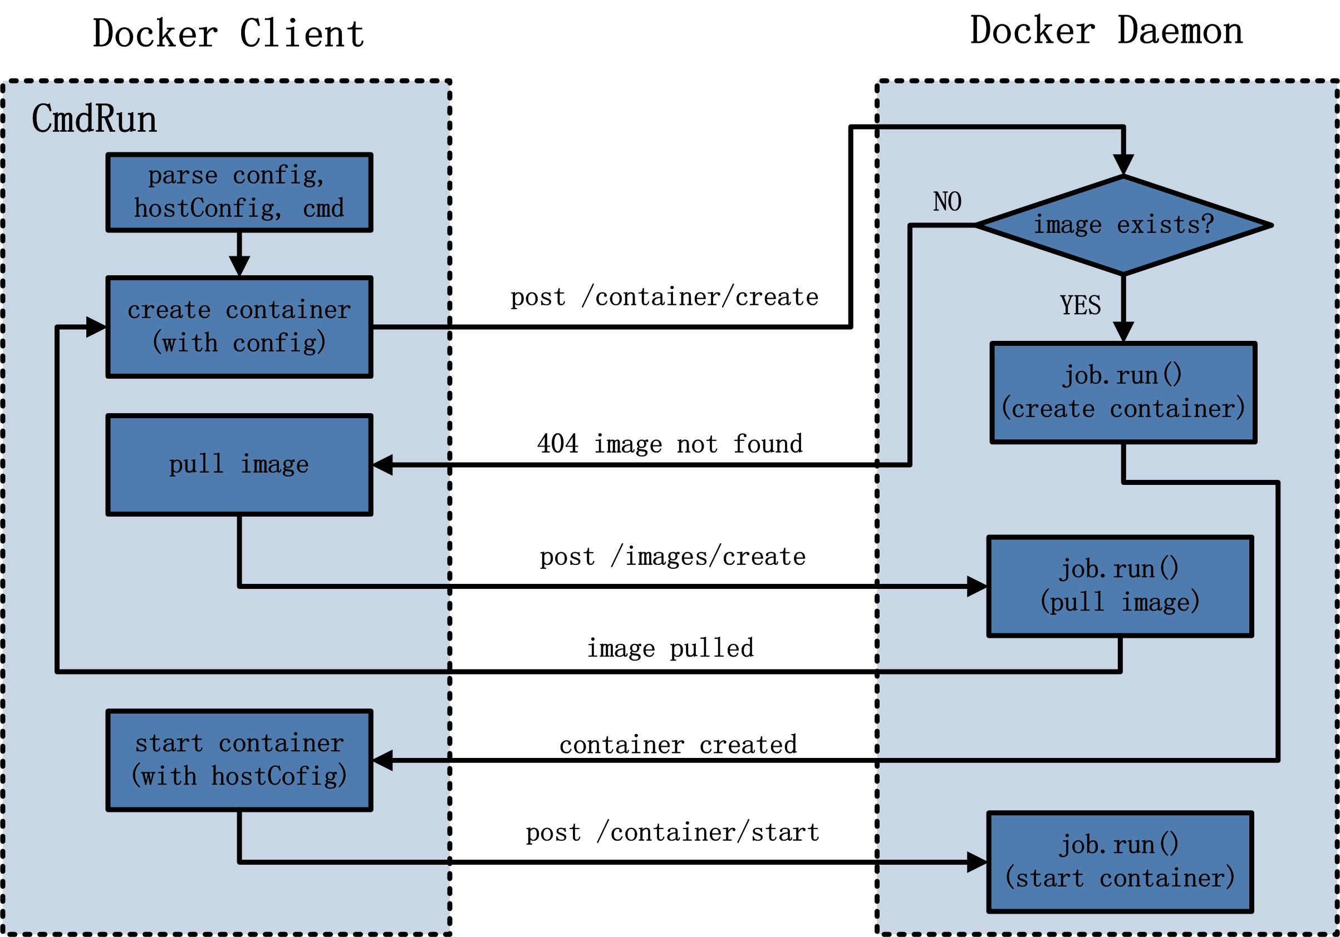
CmdRun

Slide 10
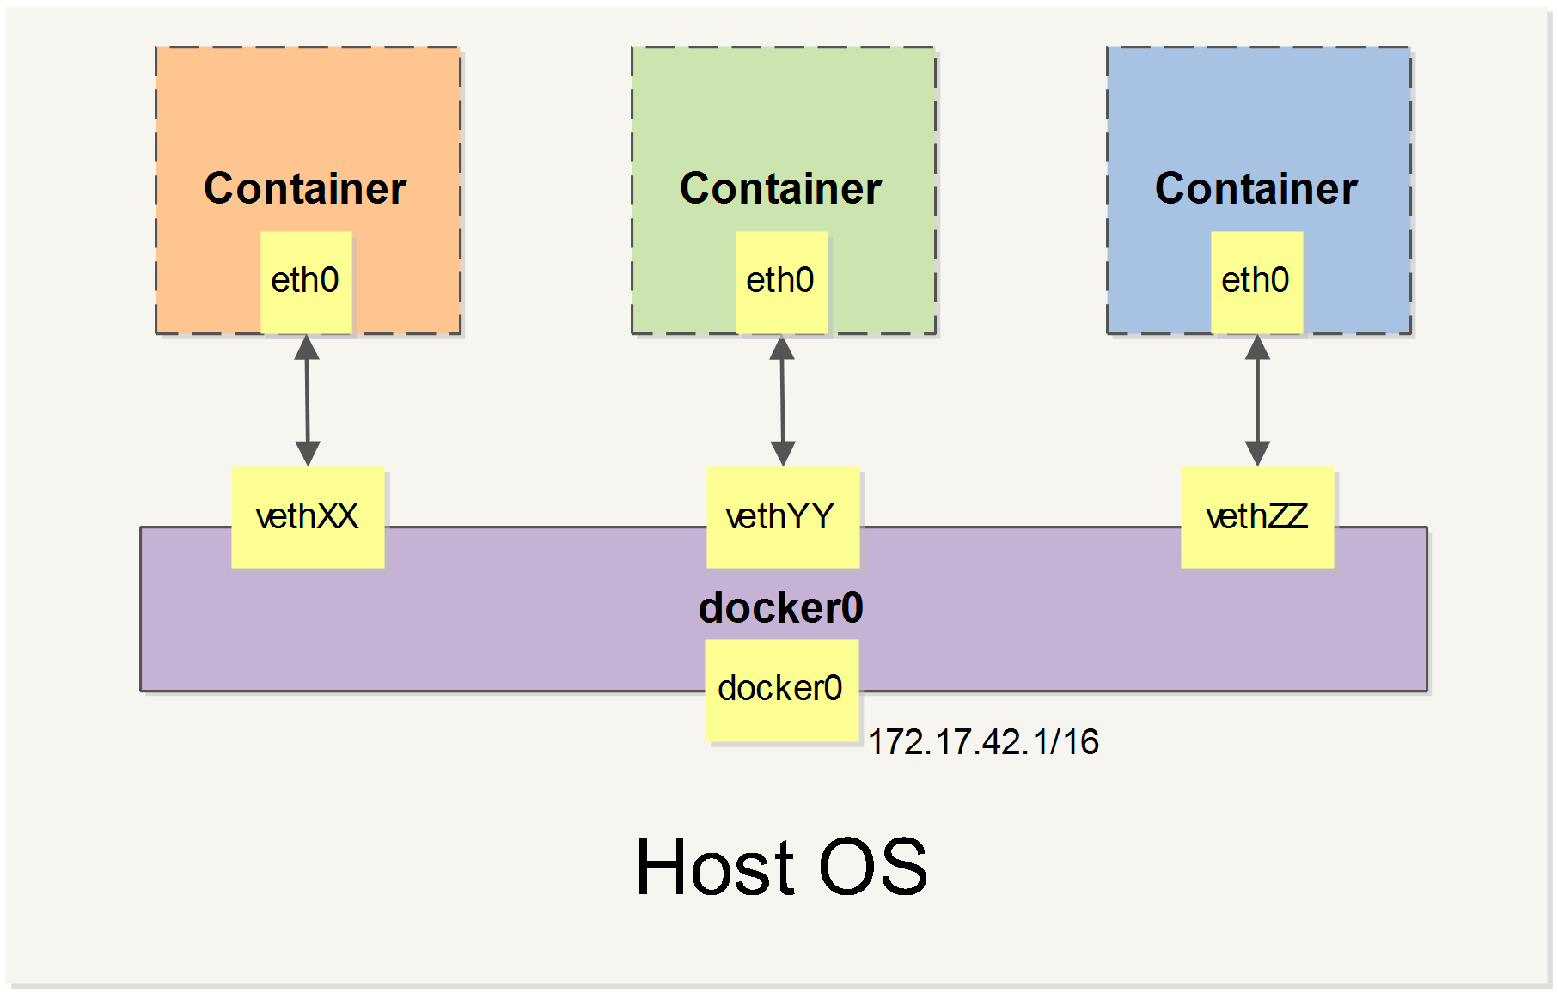
Daemon Network

Slide 11
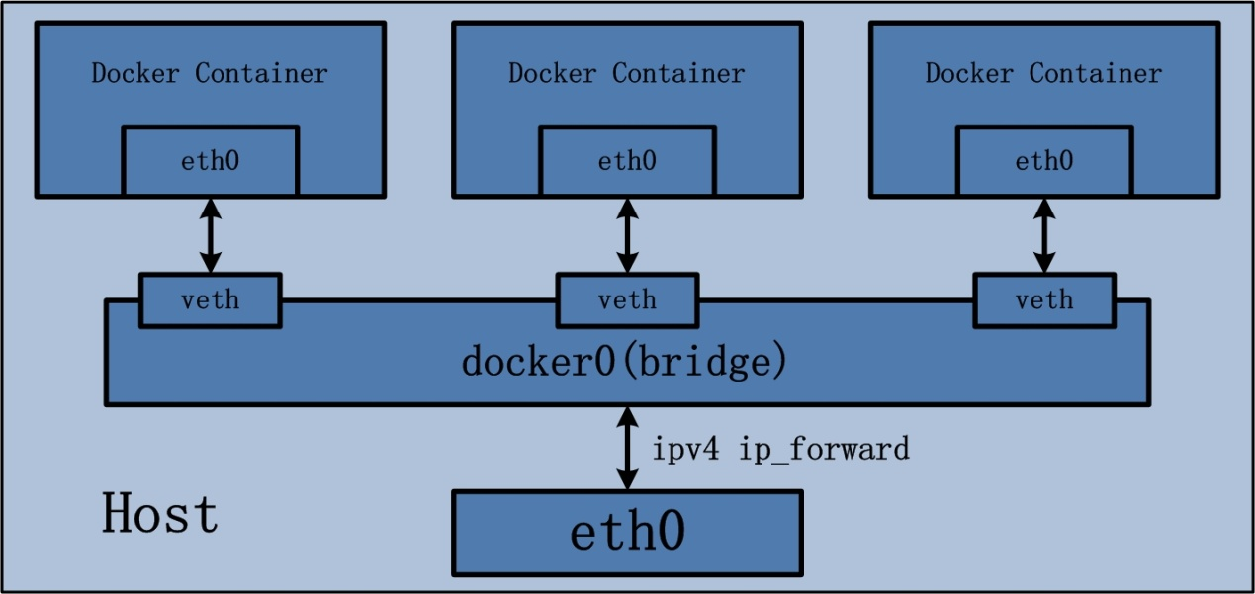
Daemon Network

Slide 12
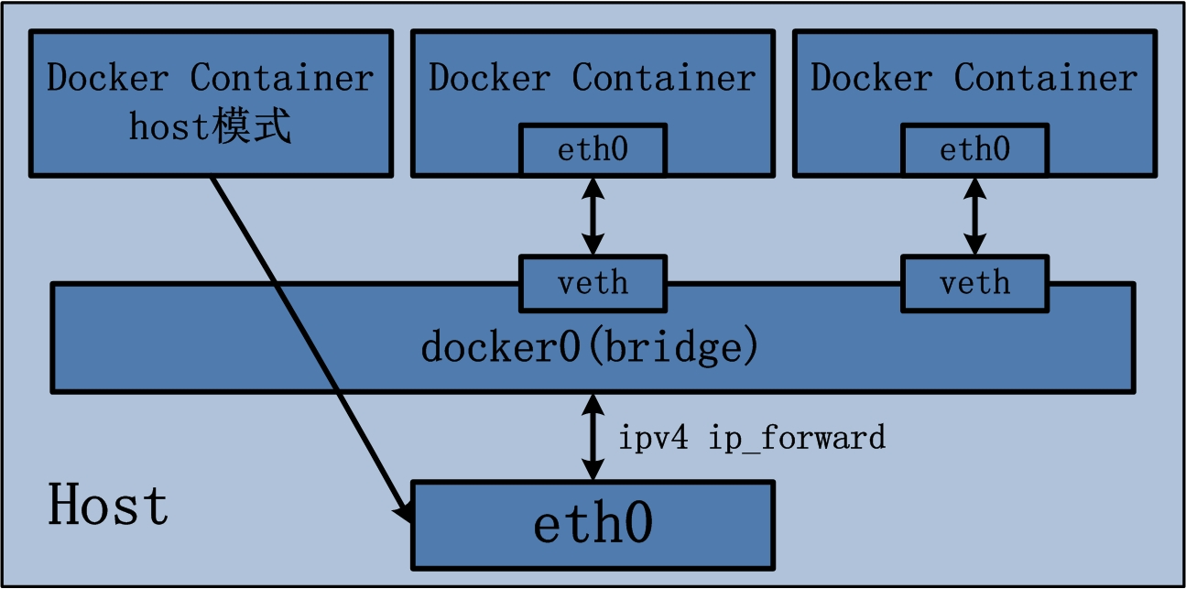
Container Host模式

Slide 13
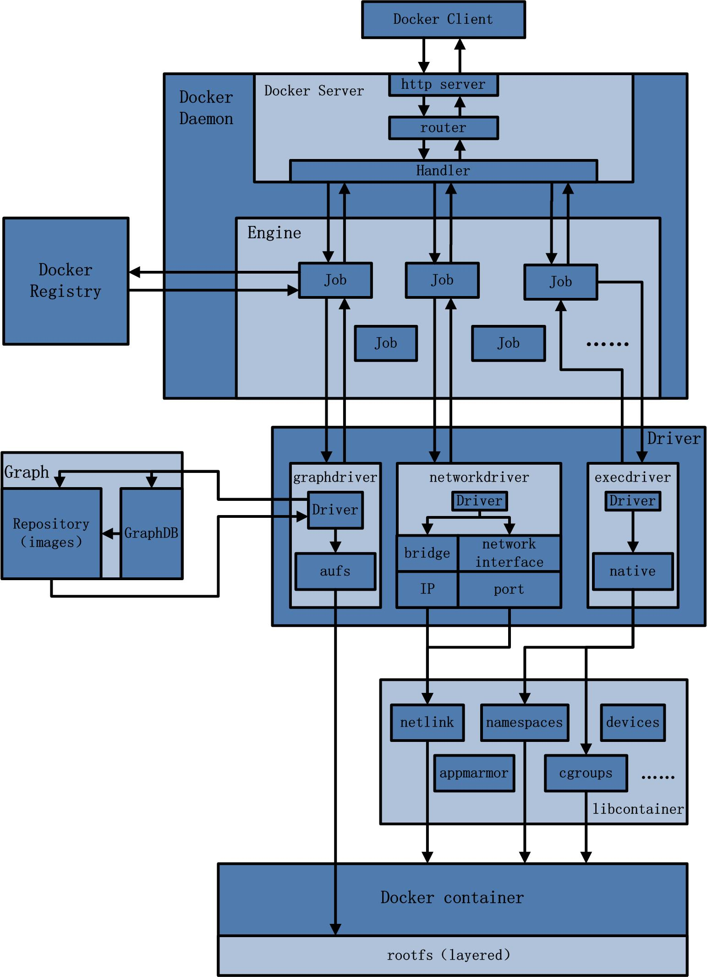
Code Arch

Slide 14
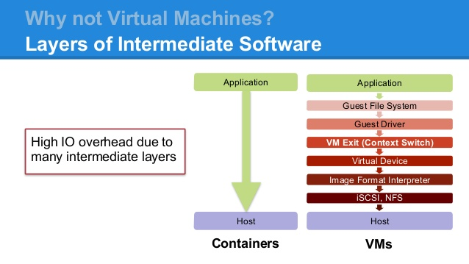
VMs vs. Containers

Slide 15
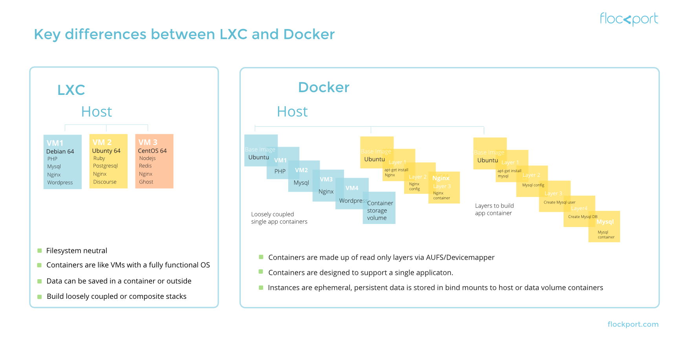
LXC vs.Docker

Slide 16
https://github.com/docker
https://github.com/docker-library/
https://github.com/docker-library/mysql

Slide 17
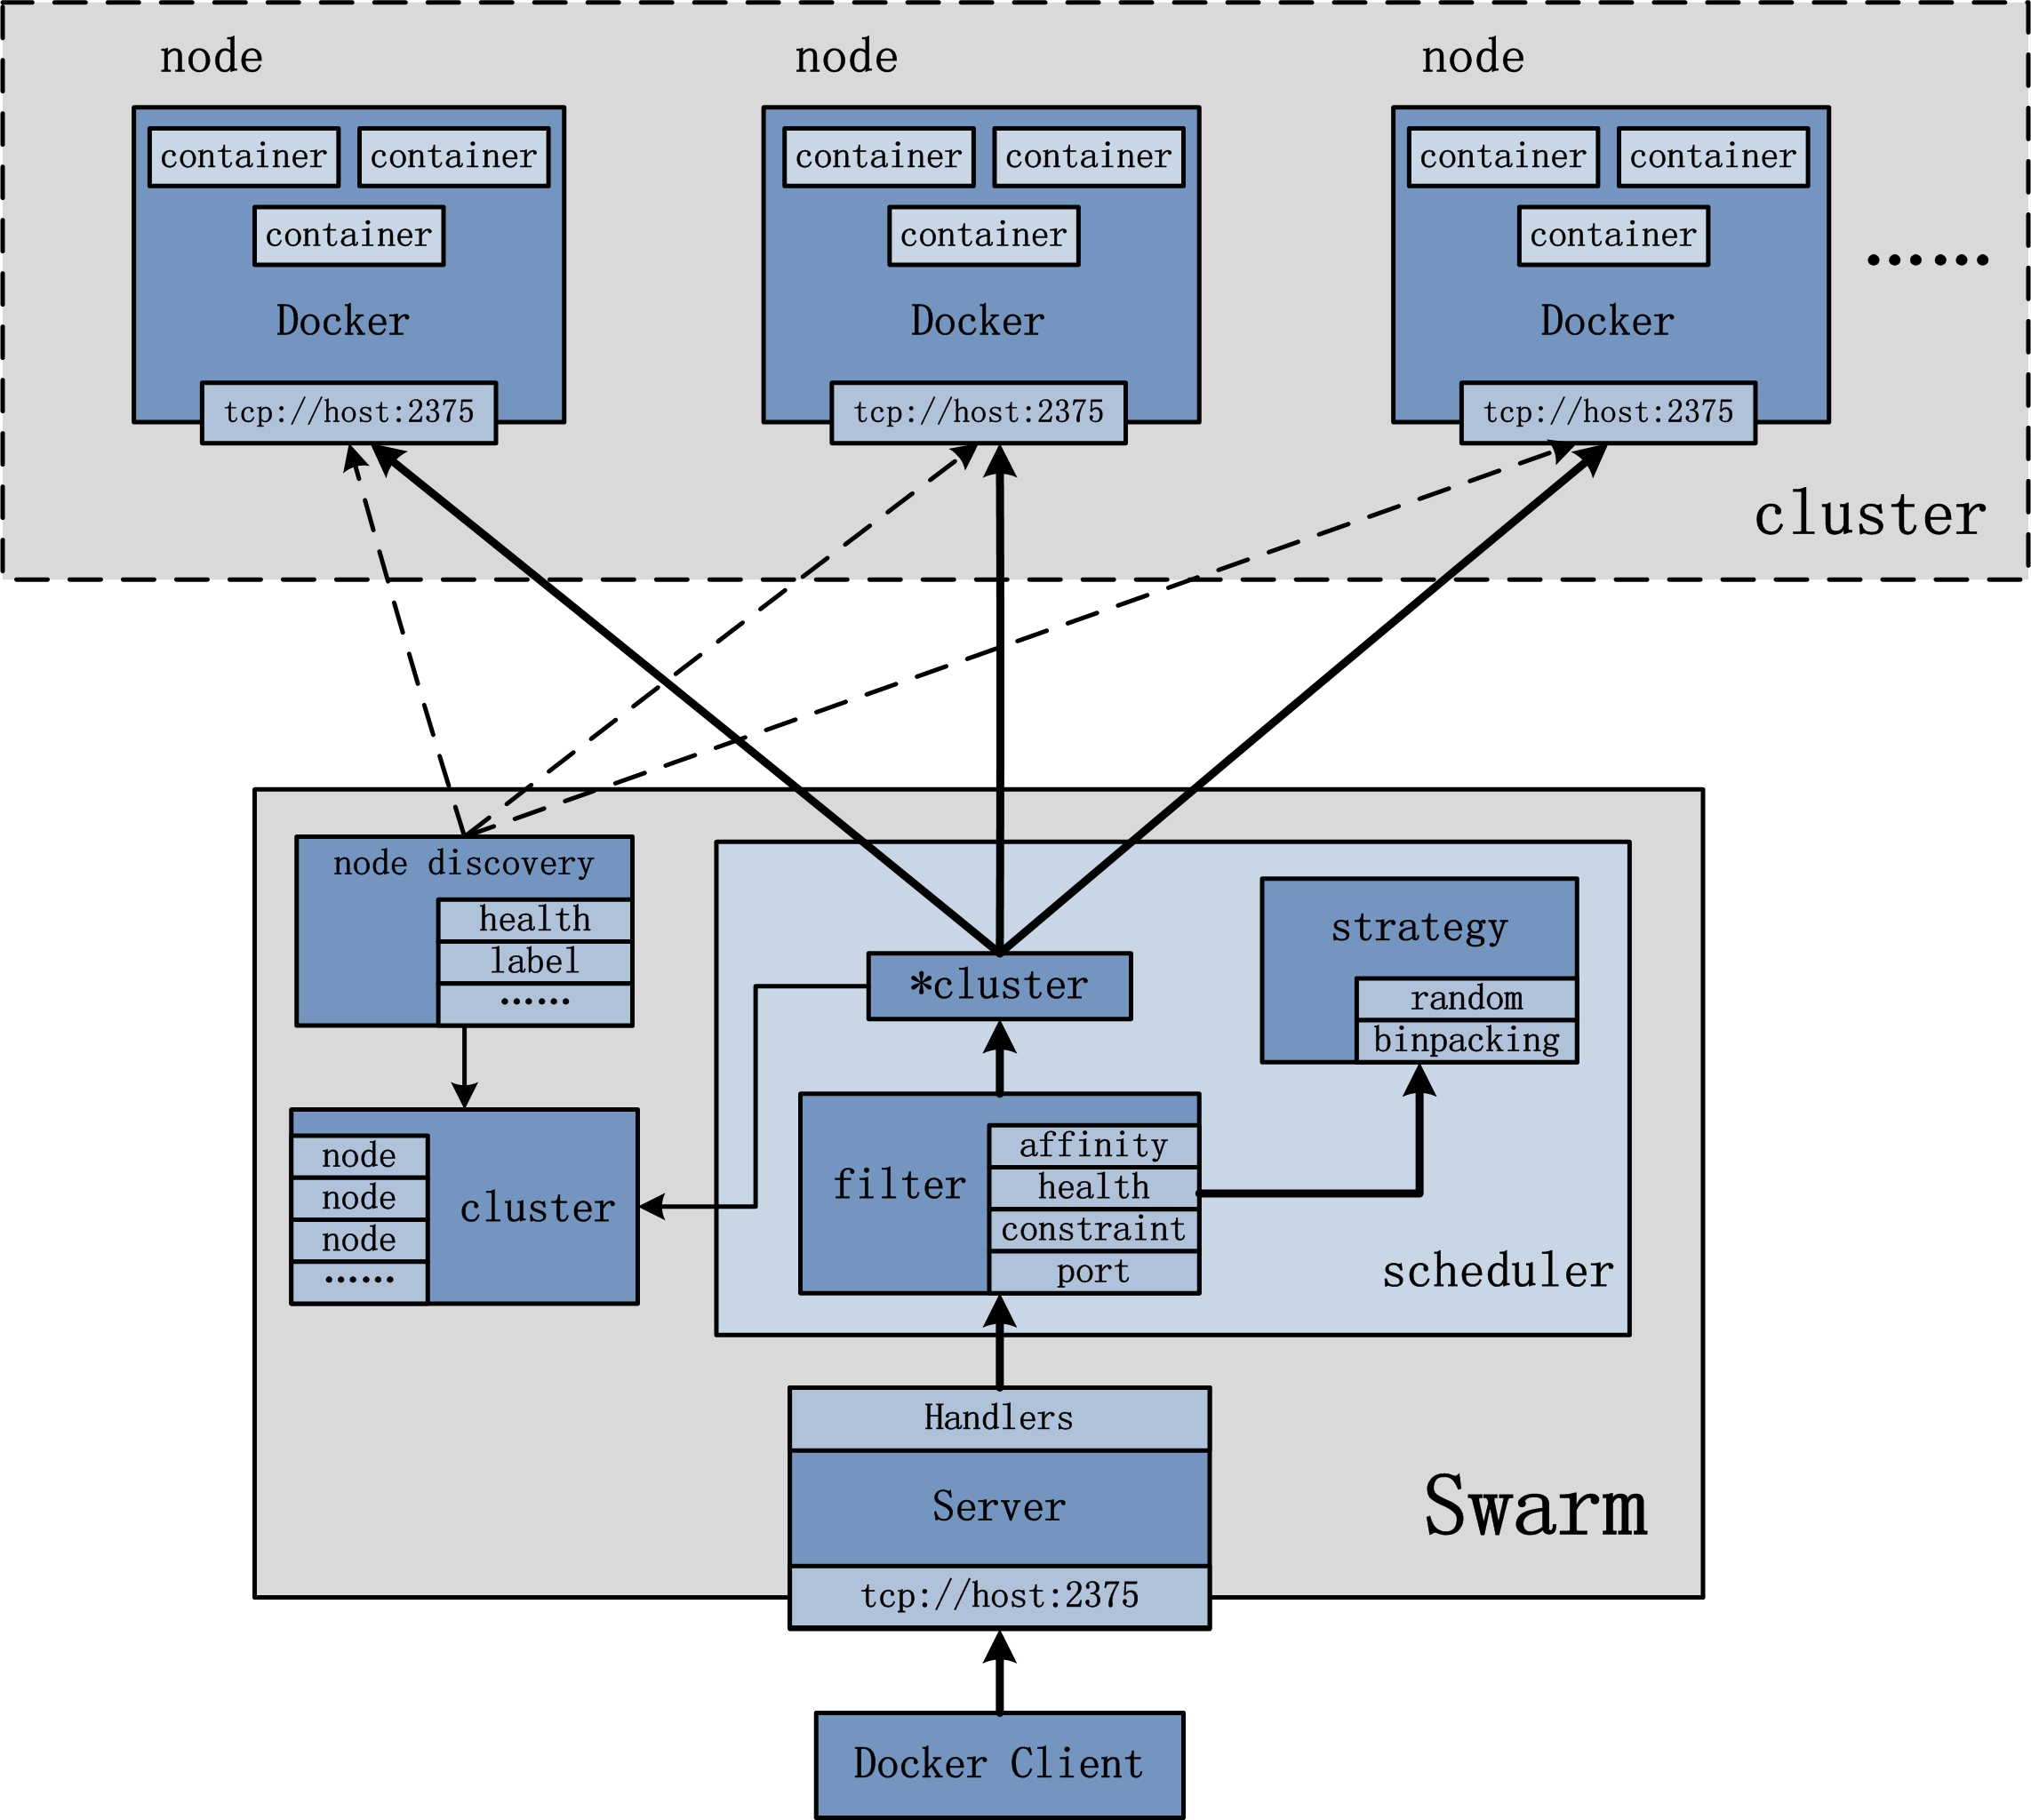
Swarm
http://blog.daocloud.io/swarm_analysis_part1/

Slide 18

kubernetes

Slide 19
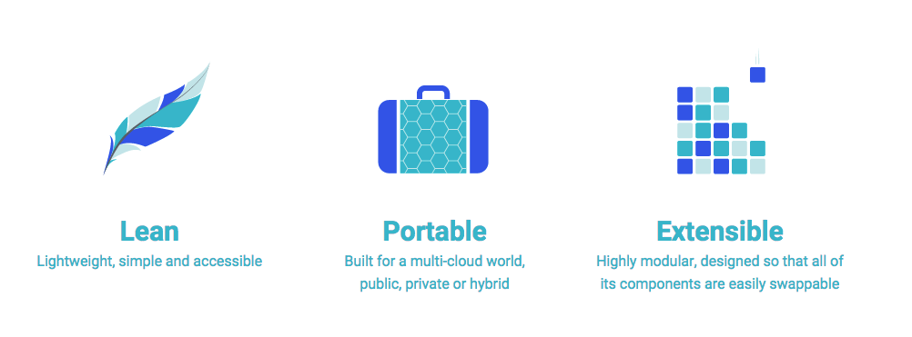
kubernetes

Slide 20
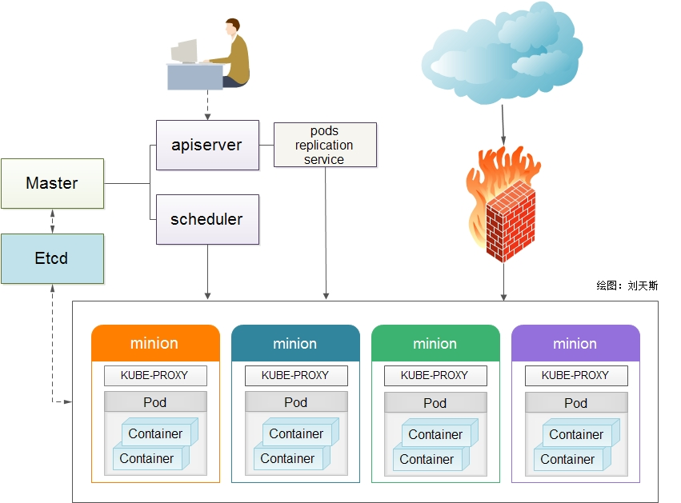
kubernetes

Slide 21
